Slide 1

Experimental & Numerical Analysis of Flow Dynamics, Flame Morphology and Emissions in a 100% Hydrogen Double-Swirl Burner under Co- & Counter- Swirl Configurations
Prof. Fabio Cozzi
Joseph Noel Kiren
2026

Slide 2
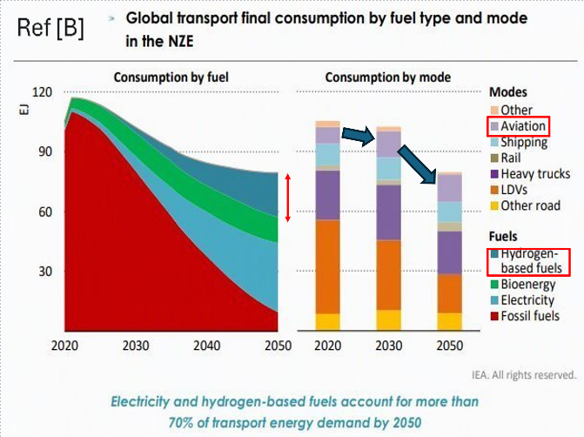

Motivation- Decarbonization & Hydrogen Transition
Decarbonization imperative: Reaching Net Zero targets requires replacing fossil fuels in major sectors; coupled with growing Global Energy Demand has created interest in Hydrogen as an alternative fuel.
Role in Aviation: Rapidly growing aviation demand requires H₂-based fuels to achieve zero-carbon-oxide combustion emissions.
The Technical Challenge: H₂ combustion introduces severe operational hurdles in flame stabilization and emission control.

Slide 3
The Hydrogen Challenge
High Reactivity & Rapid Flame Speed
High Diffusivity
Low Volumetric & Ignition Energy
High Adiabatic Flame Temperature
Flashback & Auto-ignition risk
Complicates Combustion stability, safety and efficiency.
Solution?
Stratification & Staging
Swirl Stabilization
Thermal EINOx
Dual Swirl RAPIDS-H burner​
By Zeldovich Mechanism: Need to control residence time in high temperature stoichiometric regions

Slide 4
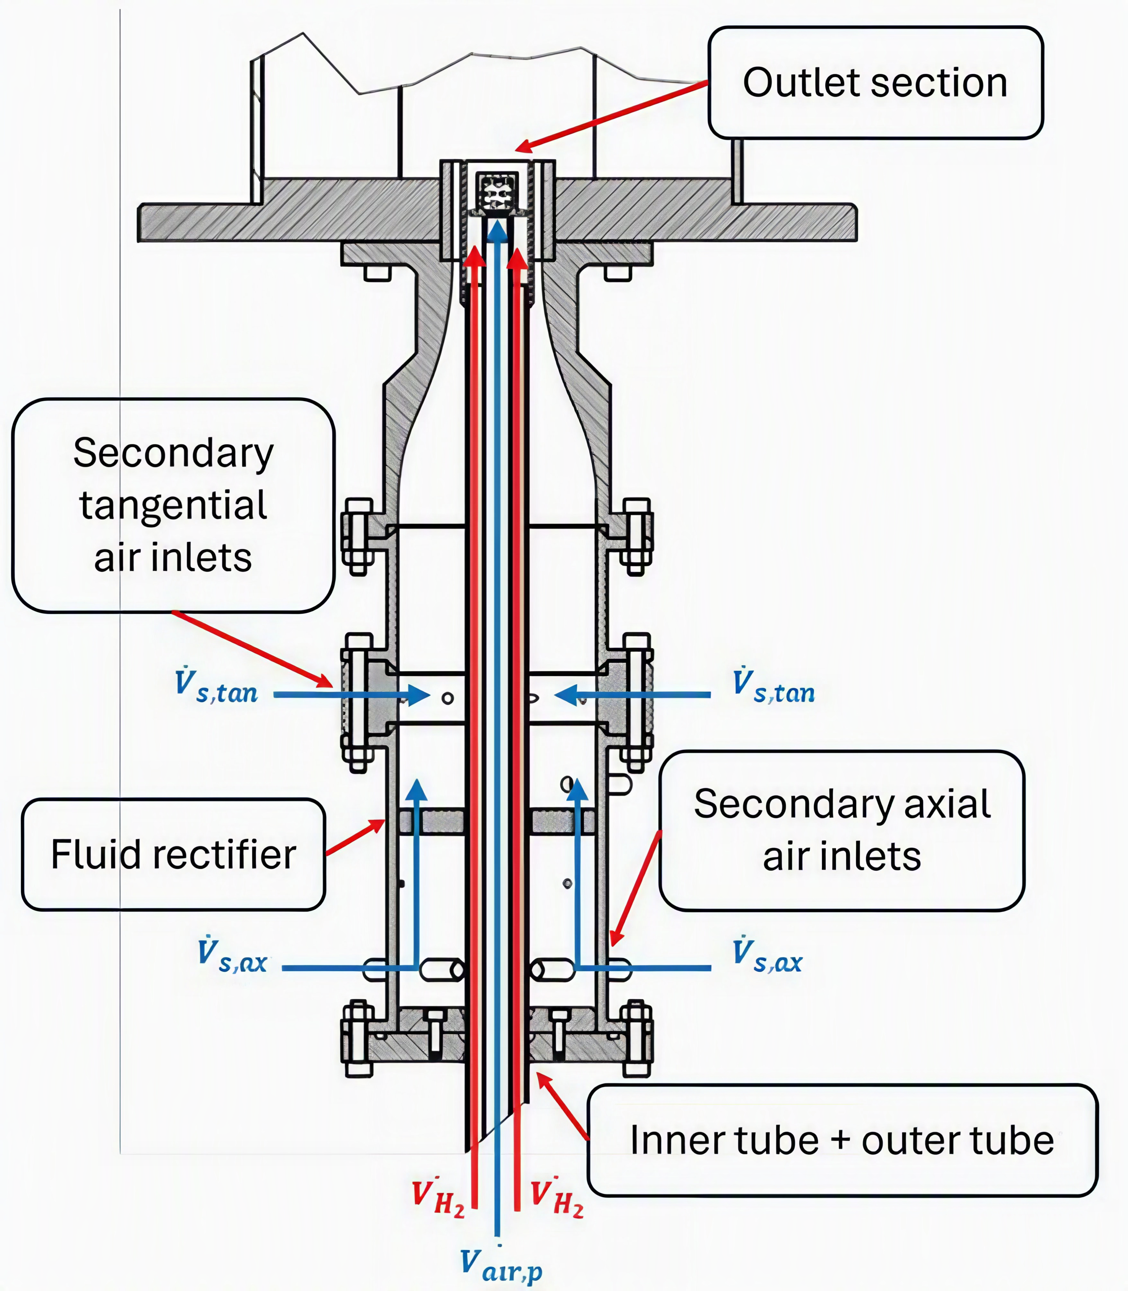
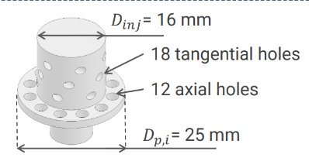




Burner Configuration & Original Contribution
RAPIDS-H Injector
Rich-Premixed, Air-staged, Dual-Swirl Injector for Hydrogen
Hydrogen
Baseline Configuration: The existing Model A co-swirl injector, which establishes a unified Central Recirculation Zone (CRZ).
Premixing Air
rich
Secondary Swirl Air:
lean

Slide 5
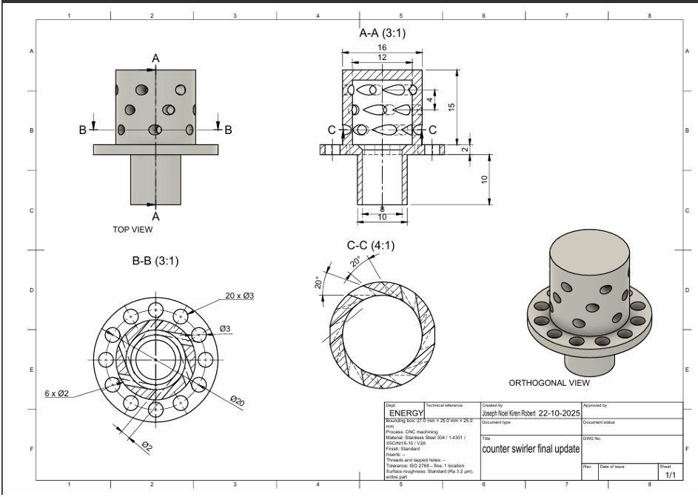
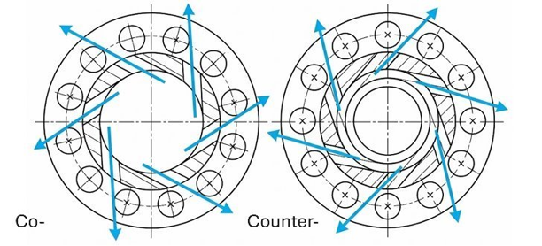
Burner Configuration & Original Contribution
Original Contributions:​
  Development, fabrication & integration of counter-swirl (CS) inner injector.
  Execution of comparative numerical (CFD) analysis of the co/counter-swirl flow structures.
  Experimental characterization of the CS injector Combustion stability & emissions. ​
This design disrupts the unified rotation by reversing inner swirl to amplify turbulent shear mixing at the stream interface.
Testing if theoretical NOx reductions outweigh aerodynamic stability penalties.​​

Slide 6
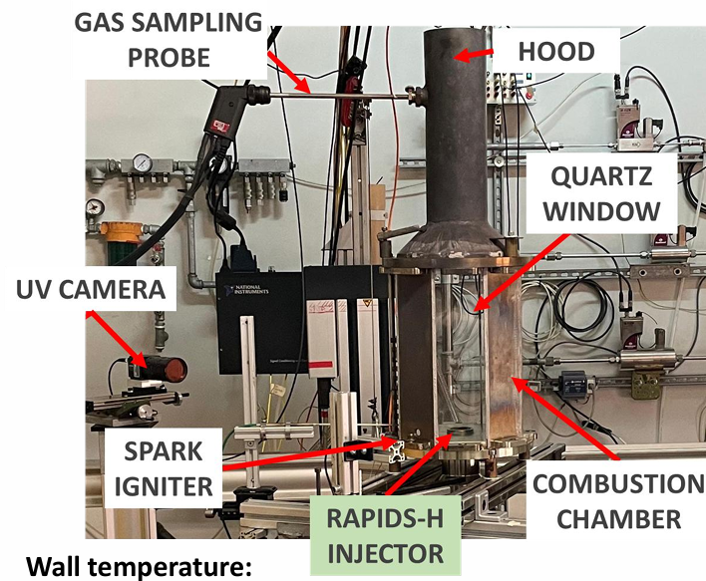
Operating Parameters summary & Diagnostic tools
Parameter | Value
Thermal Power (P th) | 12 kW
Φ global | Varied (0.25, 0.35, 0.45)
Split Ratio (SR) | Nominal 0.60 (varied 0.3 to 0.9)
Φ premix | Non-premixed (∞) to premixed (9, 7, 5)
Diagnostic instruments:
- UV imaging (OH* chemiluminescence) for flame morphology: [SVS- Vistek fxo487 MCX camera + Azure Photonics 75 mm F/3.8 ultraviolet lens+ MIDOPT Near-UV Bandpass Filter]
Continuous gas analysis for NOx emissions: [MRU MGA prime Gas Analyser]

Slide 7
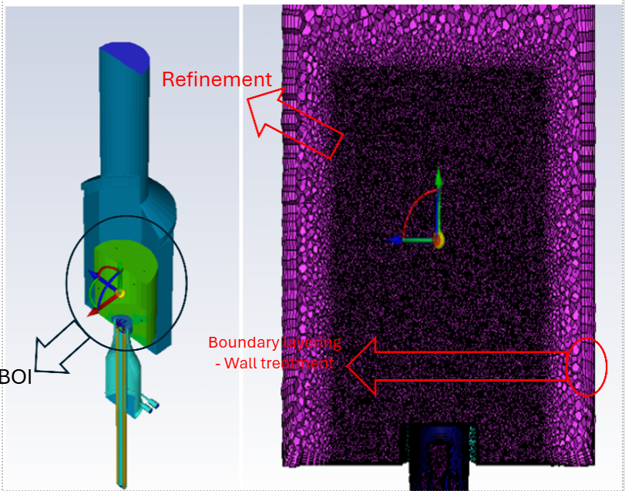
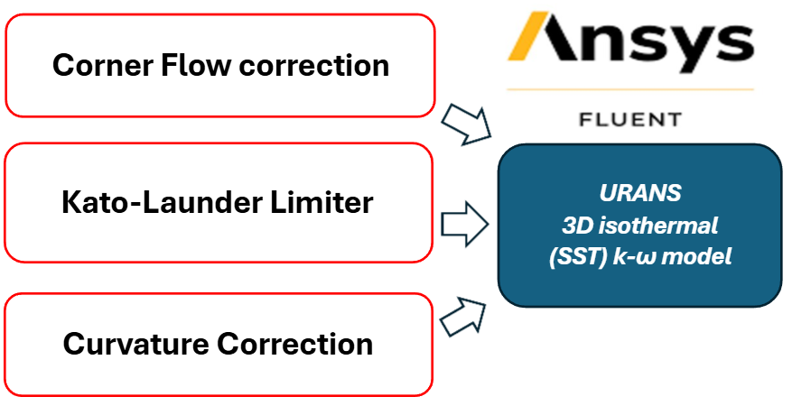
Numerical Methodology: Meshing & Solver
Solver strategy: Transient + Pressure-based + Coupled Solver
Polyhedral 3D mesh with BOI refinement

Slide 8
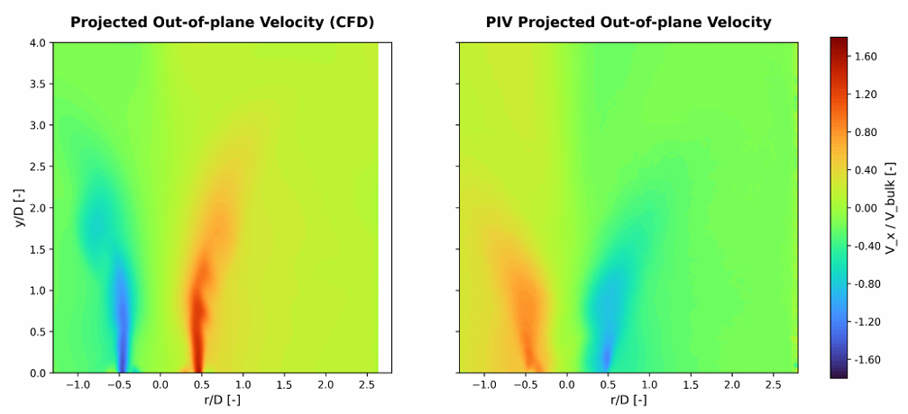
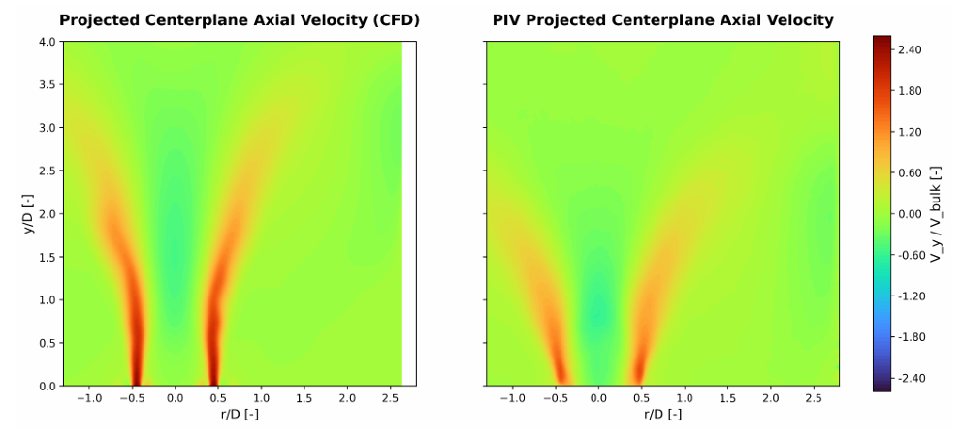
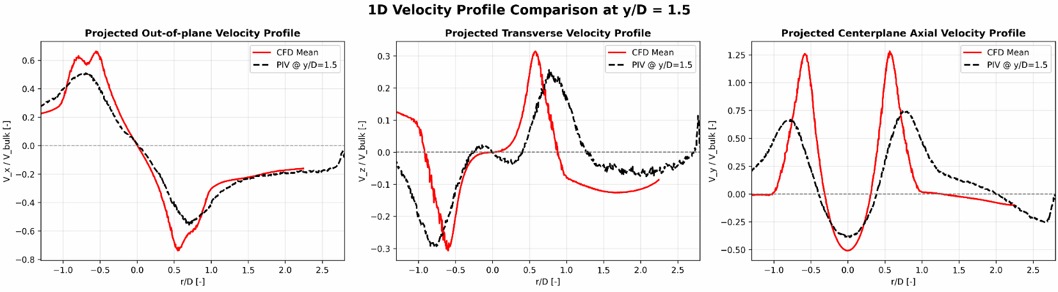
Results: Co-Swirl Validation with PIV
CFD profiles replicate flow topology of the PIV measurements- (Operational BCs from Baseline Co-swirl run: Φ global = 0.45 , Φ premix = 5, SR = 0.60)
M shaped Divergent jet & a Reverse flow pocket of CRZ noticed

Slide 9
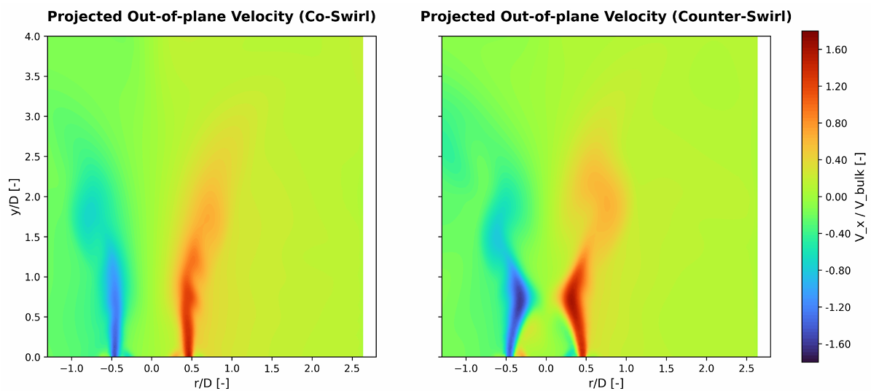
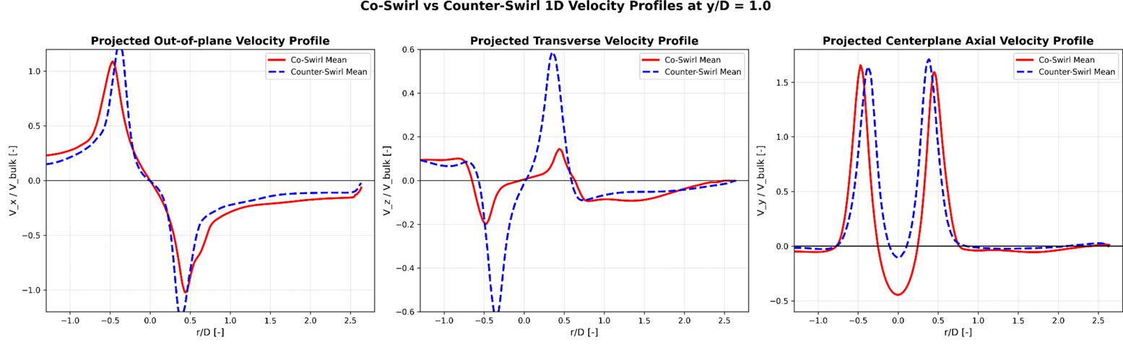
Counter-Swirl behaviour with respect to the Co-Swirl
Cartesian-to-Polar Velocity component guide:
Centerplate Axial= Axial
Projected Out-of-plane = Tangential
Projected Transverse = Radial
Reversing the inner swirl generates intense interfacial shear between the opposing rotational streams.
CS CRZ Structure: opposing momentum > restricts radial dispersion > insufficient centrifugal expansion > lack of strong adverse pressure gradient > Weaker CRZ.
​

Slide 10
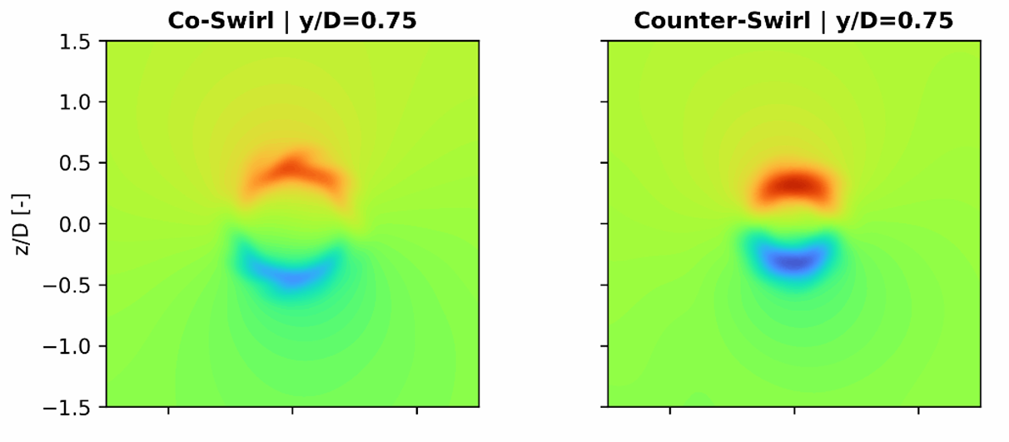
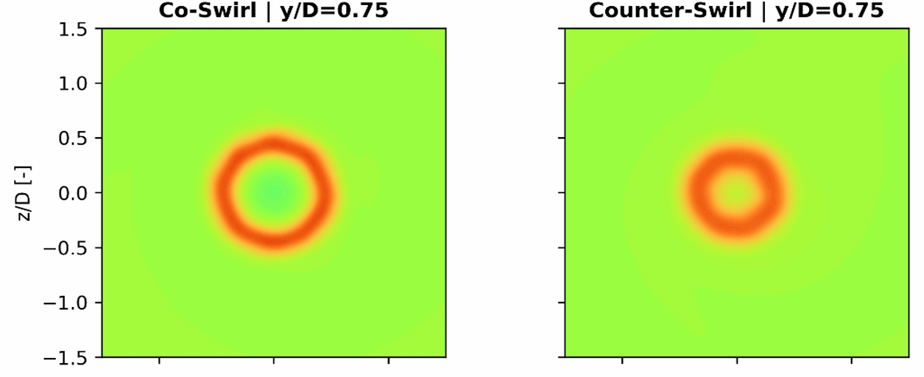
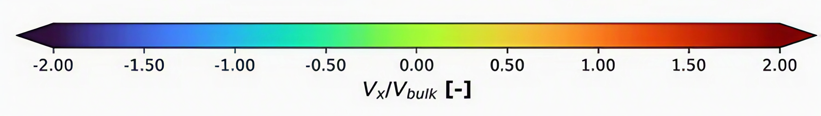
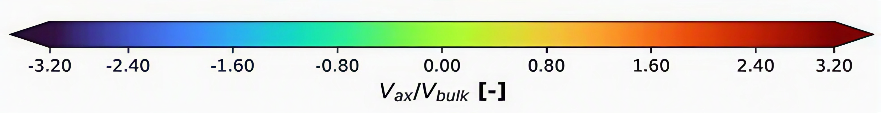
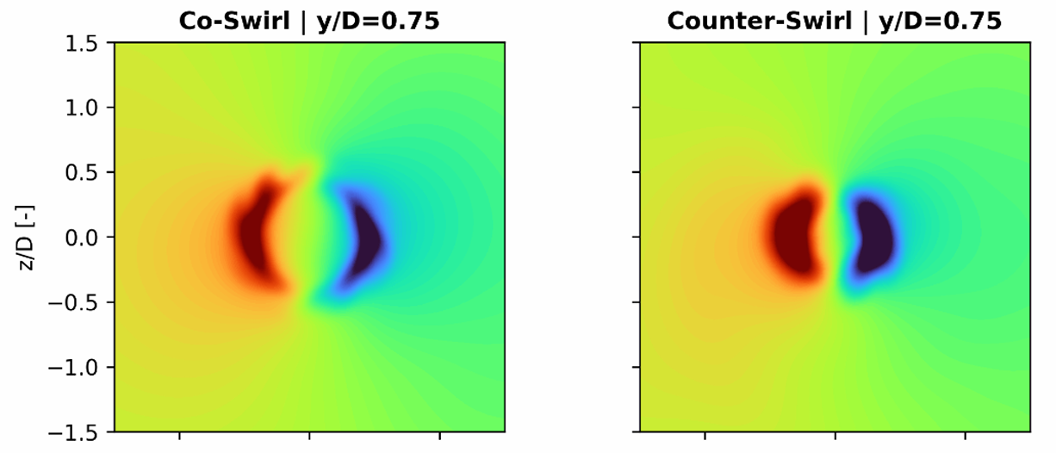
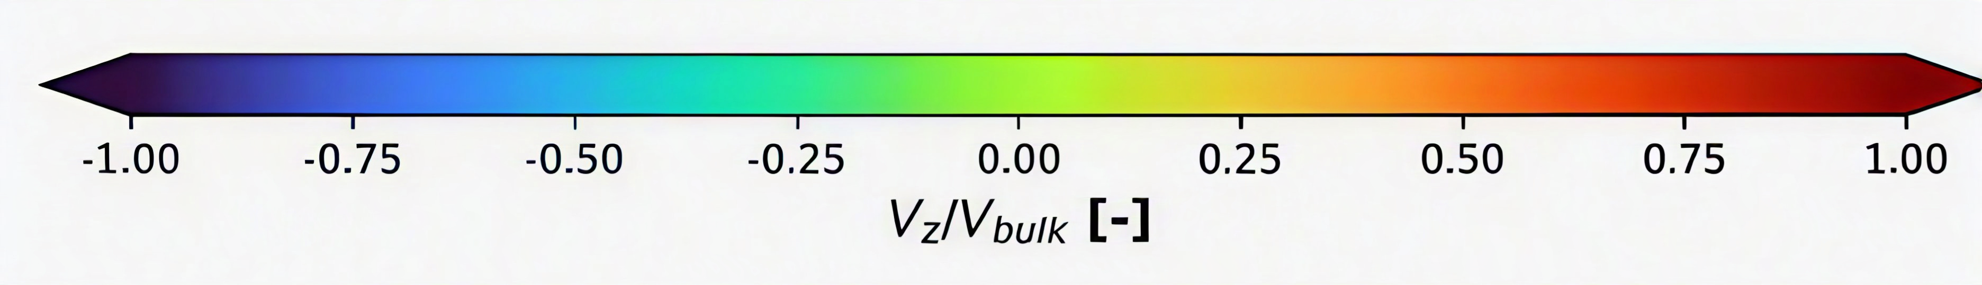
CRZ development downstream Co- vs Counter- @ y/D=0.75
Evolution of Vx velocity
Evolution of Vy velocity
Axial Velocity (Vy): Lacking sufficient radial spread to induce a sufficient adverse pressure gradient, the CRZ narrows & weakens.
-1
-1​
1​
-1​​
0
1​​
-1​
0​
0
0​​
1​​
1
Evolution of Vz velocity
Tangential Velocity (Vx): Reversed inner rotation generates intense interfacial shear between the opposing streams.​
Radial Velocity (Vz): Opposing momentum restricts centrifugal expansion, preventing outward spread.
-1​
0​
​
1​​
-1​
0​​
​
1​

Slide 11
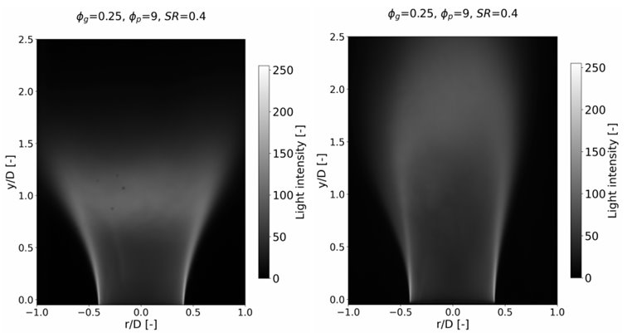
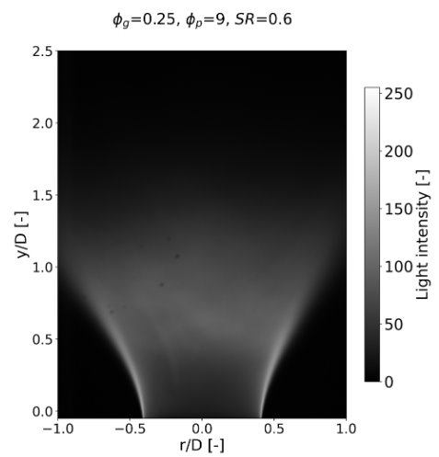
Flame Morphology: Counter-swirl with respect to Co-swirl
Counter Swirl tests:​
Φ global= 0.35 & 0.45: Premixing caused immediate flashback​.
Φ global= 0.25: Maintained only transient stability (below) before eventually flashing back.​
Co-Swirl
Counter-Swirl
Counter-Swirl
Co-Swirl:
Maintains stable, aerodynamically anchored M-shaped flames across most conditions (see Appendix C)​.
Counter-Swirl: ​
Weakened CRZ as predicted by CFD.​
Flashback prone: vulnerable to Flashback under premixing.​

Slide 12
EINOx Results & Limitations
The Flashback Limitation: Because severe flashback prevented data acquisition over the rest of the premixed operating range for Counter-Swirl:
The EINOx dataset is heavily restricted.
Cannot evaluate Aerodynamic effect of swirl reversal completely.
Φ global | SR | Φ premix | Co-Swirl EINOx NOx / kg H₂ | Counter-Swirl EINOx NOx / kg H₂
0.25 | 0.40 | 9.00 | 2.91 | 2.55
0.45 | 0.60 | 9.00 | 2.40 | Flashback (No Data)
At the only comparable partially premixed condition (Φg =0.25, Φp=9, SR=0.40), counter-swirl yielded slightly lower EINOx (2.55 vs 2.91 g/kg H₂)- with ±5.1% measurement uncertainty.
A single data point is insufficient to establish a systematic, repeatable emissions benefit for the counter-swirl configuration.

Slide 13
Conclusions and Future Work
Conclusions:
Aerodynamics: Reversing the inner swirl restricts radial dispersion and weakens the CRZ.
Stability: This weakened aerodynamics results in a stability penalty, making the counter-swirler highly vulnerable to flashback under 100% H₂ premixed operation.
Emissions: Flashback limits preclude the confirmation of any systematic NOx benefit.
Future Work:​
​
Reacting LES & Kinetics: Transition to reacting LES coupled with detailed kinetic mechanisms (Chemkin) to study thermal expansion effects on CRZ stability and NOx pathways.​
Physics-Informed AI (PINNs): Leverage validated PIV and CFD datasets to train PINNs for inferring unmeasured flow fields, specifically 3D pressure distribution and core recirculation dynamics.​

Slide 14
Closing
Thank you for your Attention

Slide 15
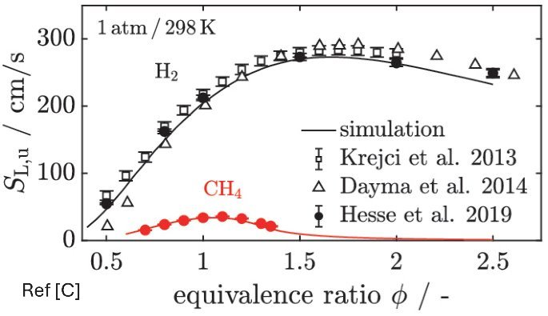
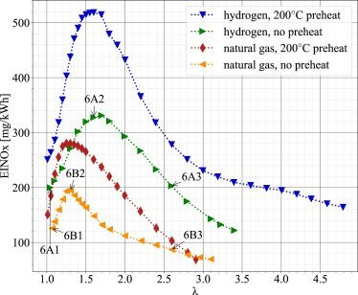
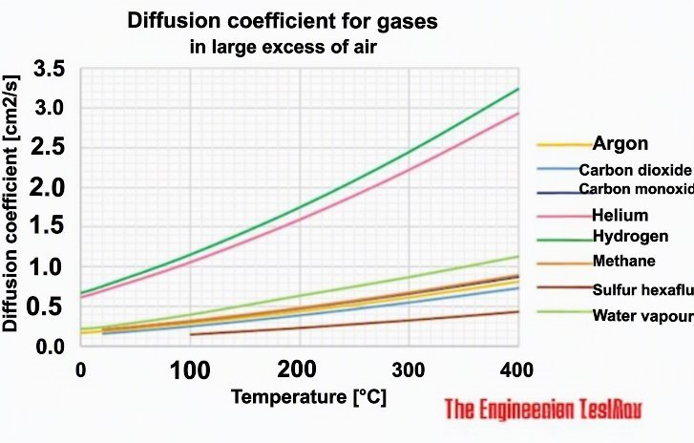
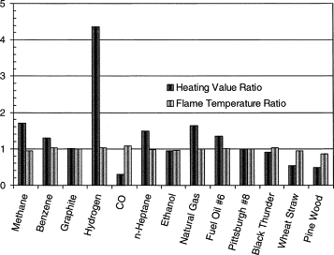
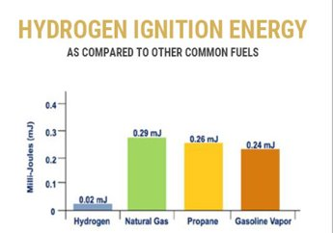
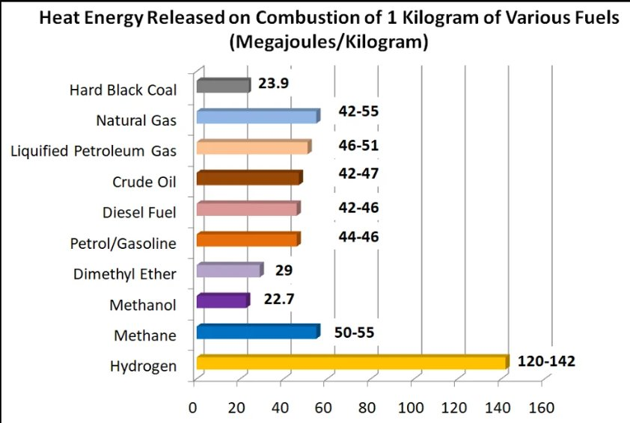
Appendix A.0 : Hydrogen Properties
Picture [Ref B]: International Energy Agency. (2021). Net Zero by 2050: A roadmap for the global energy sector. IEA. (chapter 3)

Slide 16

Appendix A: Detailed Numerical Methodology
Turbulence Modelling: The Shear-Stress Transport (SST) k-ω model was employed to bridge near-wall accuracy with free-stream stability. To capture the highly anisotropic dynamics of the double-swirl burner
Parameter | Selected Setting in Thesis
Discretization Framework | Finite Volume Method (FVM)
Mesh Topology | Polyhedral Mesh with Inflation Layers
Local Refinement Strategy | Body of Influence (BOI)
Turbulence Approach | Unsteady Reynolds-Averaged Navier-Stokes (URANS)
Turbulence Model | Shear-Stress Transport (SST) k-ω Model
Near-Wall Treatment | Kader Blending (Automatic Wall Treatment, y+∼1 to Buffer Region)
Swirl Correction | Curvature Correction
Flow Correction | Corner Flow Correction
Turbulence Production Limiter | Kato-Launder Production Limiter
Pressure-Velocity Coupling | Coupled Scheme
Transient Formulation | Bounded Second-Order Implicit Formulation
Spatial Discretization | Second-Order Upwind Scheme
Gradient Evaluation | Least Squares Cell-Based Method
Kato-Launder Limiters: Replaces strain with vorticity in the production term to suppress the unphysical generation of turbulent kinetic energy (TKE) near irrotational stagnation points.
URANS
3D isothermal
(SST) k-ω model
Corner Flow Correction: Dynamically modifies turbulent viscosity to preserve swirling streamlines and prevent over-predicting corner separation.
Curvature Correction: Sensitizes the turbulence production to rotation, preventing the artificial dampening of angular momentum critical for the Central Recirculation Zone (CRZ).

Slide 17
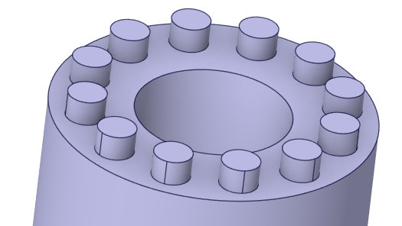
Appendix A: Detailed Numerical Methodology
Inlet Patch | Computed Velocity
Secondary Axial Air | 0.510 m/s
Secondary Tangential Air | 4.352 m/s
Premix Air | 7.278 m/s
Air Substituting H2 * | 1.041 m/s
Operational Boundary Conditions (Baseline: Φ global = 0.45 , Φ premix = 5, SR = 0.60)
*Safety Scaling: To safely conduct isothermal simulations and non-reacting tests, the actual H2 flow was substituted with a momentum-equivalent air flow rate to precisely preserve the inner jet momentum flux.

Slide 18
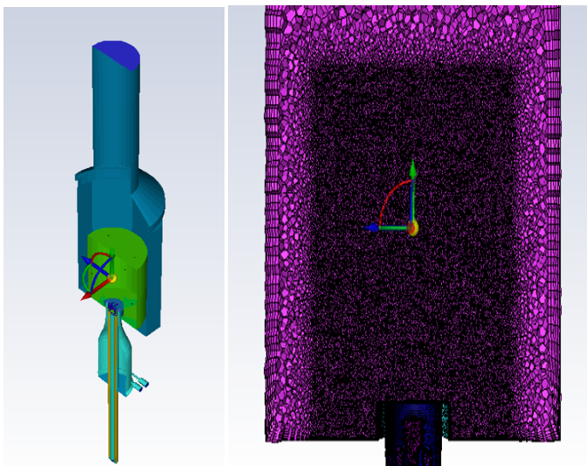
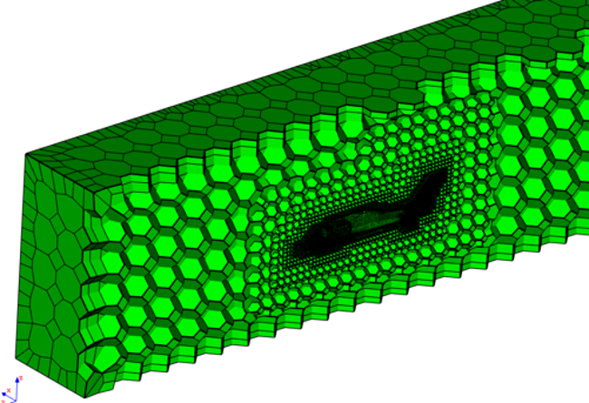
Appendix A: Detailed Numerical Methodology
Meshing Strategy & Independence: A 3D polyhedral mesh topology (see figure below) was utilized to maximize spatial gradient approximations and limit numerical diffusion in the swirling flows.
A Body of Influence (BOI) cylinder (see green cylinder in the left picture) restricted aggressive local refinement to the near-field mixing and CRZ regions (far right picture), yielding final counts of ~2.8 million cells (co-swirl) and ~2.2 million cells (counter-swirl).
Refinement
Boundary layering
- Wall treatment
BOI
Meshing Strategy: Volume Extract > Water-tight geometry mesh approach > Targeted Refinement, Body of Influence (BOI) & Boundary Layering > Polyhedral 3D meshing

Slide 19
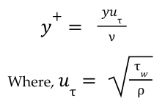
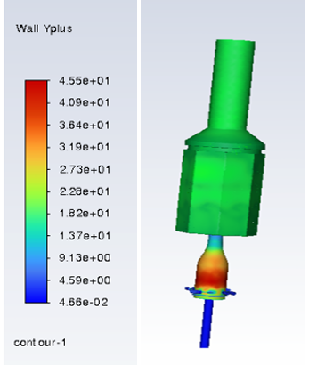
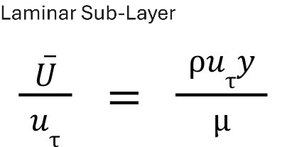
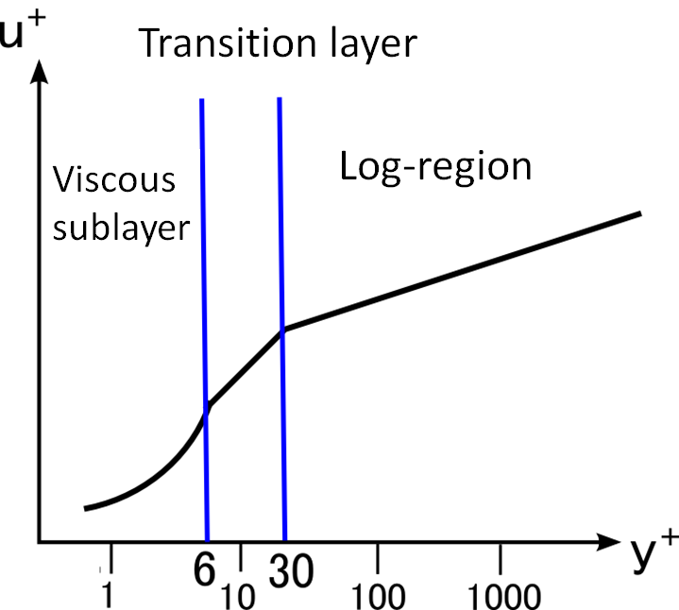
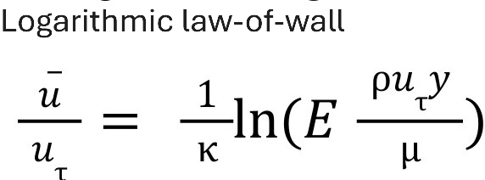
Appendix A: Detailed Numerical Methodology
Near-Wall Treatment & Y+: The mesh featured 5 prism inflation layers with a targeted y+ close to 1 and strictly under 5. However, intense velocity gradients inside the outer-swirler bottle inevitably caused localized y+ peaks between 20-45.
Enforcing a uniform y+ ~ 1 everywhere would cause cell counts to explode and the mesh to collapse due to extreme transition scales.
To safely resolve this, the Kader blending wall function was strictly enforced. This mathematically bridges the laminar sublayer [y+~1-5] & the logarithmic law-of-the-wall [y+~30-300], providing a necessary, accurate trade-off that protects global mass conservation without unaffordable computational costs.

Slide 20
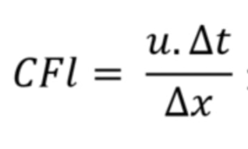
Appendix A: Detailed Numerical Methodology
Solver Dynamics & CFL Condition: A two-phase solution strategy was executed using a Pressure-Based Coupled Solver, which resolves mass and momentum simultaneously to enhance numerical robustness against severe adverse pressure gradients.
The solution was executed utilizing a two-phase solver strategy to balance physical accuracy with computational efficiency (saves on time steps needed for the flow development & CRZ establishment)
CFL Constraints: This optimized time step maintained a highly conservative global Cell Convective Courant Number (CFL) of ~ 0.11, peaking at only 1.35 in the absolute highest-velocity regions, preserving extreme temporal fidelity. ​
Transient Execution:
The simulation transitioned to a bounded second-order implicit transient formulation. To prevent numerical shock, an "ease-in" time-stepping strategy was used (starting at 0.00001~s), before settling at an optimized 0.00025~s time step.
Steady Initialization:
An initial steady-state run (3,000 iterations) established the fully developed velocity profiles and adverse pressure gradients, flushing out initialization noise.
Both the cases were run for a physical time of 0.3s (this is after the flow has established and stabilized with the local FTT far exceeding the 3-5 threshold advised)

Slide 21
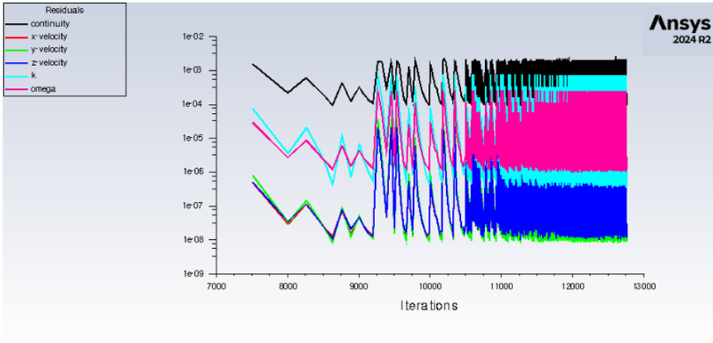
Appendix A: Detailed Numerical Methodology
Convergence Verification: Residual controls were enforced as follows:
-1E-06 for Cartesian velocity components to resolve directional shear
-1E-05 for k & ω
-The continuity residual naturally plateaued at 1E-04 due to intense pressure-velocity coupling: a global boundary mass flux evaluation yielded a negligible imbalance of 0.0002%, satisfying the <0.2% industry standard for continuity resolution.
The transient residual "sawtooth" pattern visually maps the stabilization of the pressure-velocity coupling. As flow dynamics establish, internal iterations per time step decrease, yielding a densely packed, high-frequency residual footprint.
Final residual values:
Configuration | Continuity | X-velocity | Y-velocity | Z-velocity | k | ω
Counter-swirler | 2.8110e-03 | 1.7880e-07 | 1.4582e-06 | 1.8488e-07 | 6.1369e-06 | 3.2720e-05
Co-swirler | 2.5922e-03 | 1.5932e-07 | 3.4902e-07 | 1.9510e-07 | 3.2629e-06 | 4.0278e-05

Slide 22
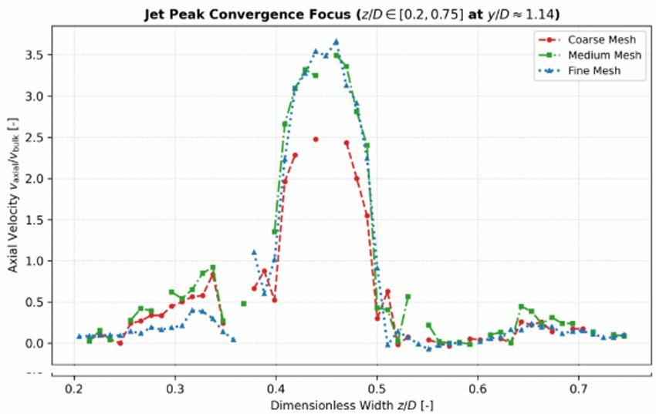
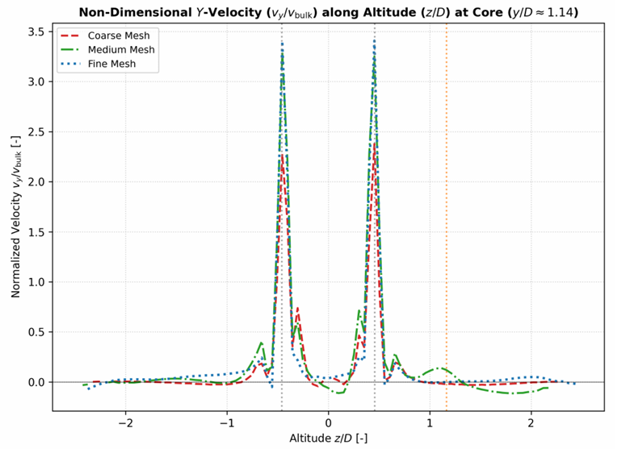
Appendix A: Mesh Independence
Mesh Independence: A sensitivity study across coarse (~440k)- red, medium (~830k)- green, and fine (~2.2M)- blue, grids proved independence, as the extracted velocity profiles for the medium and fine meshes exhibited near-identical overlay patterns​.

Slide 23
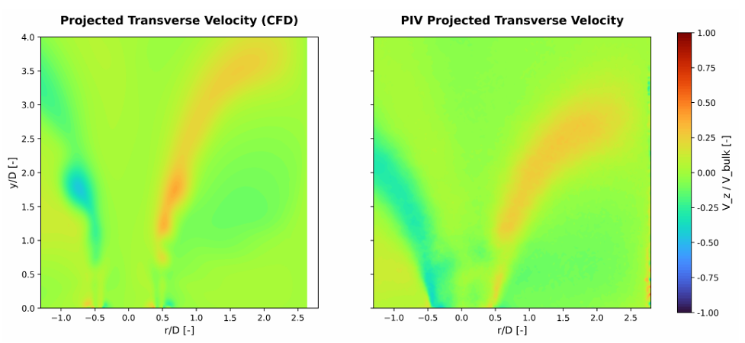
Appendix B: CFD vs PIV
Co-Swirl Validation: The transient CFD profiles successfully reproduce the macroscopic flow topology recorded in previous Stereo-PIV measurements, explicitly capturing the wide, M-shaped divergent jet trajectory and the robust reverse-flow pocket of the CRZ. ​

Slide 24
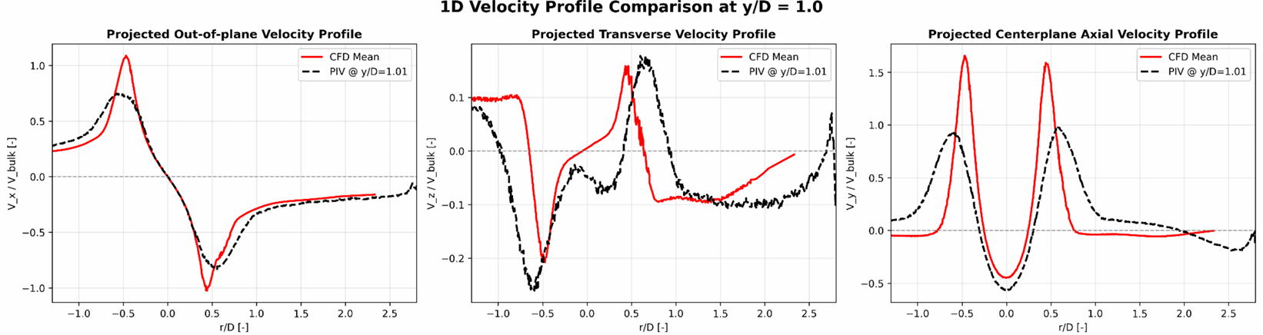
Appendix B: CFD vs PIV

Slide 25
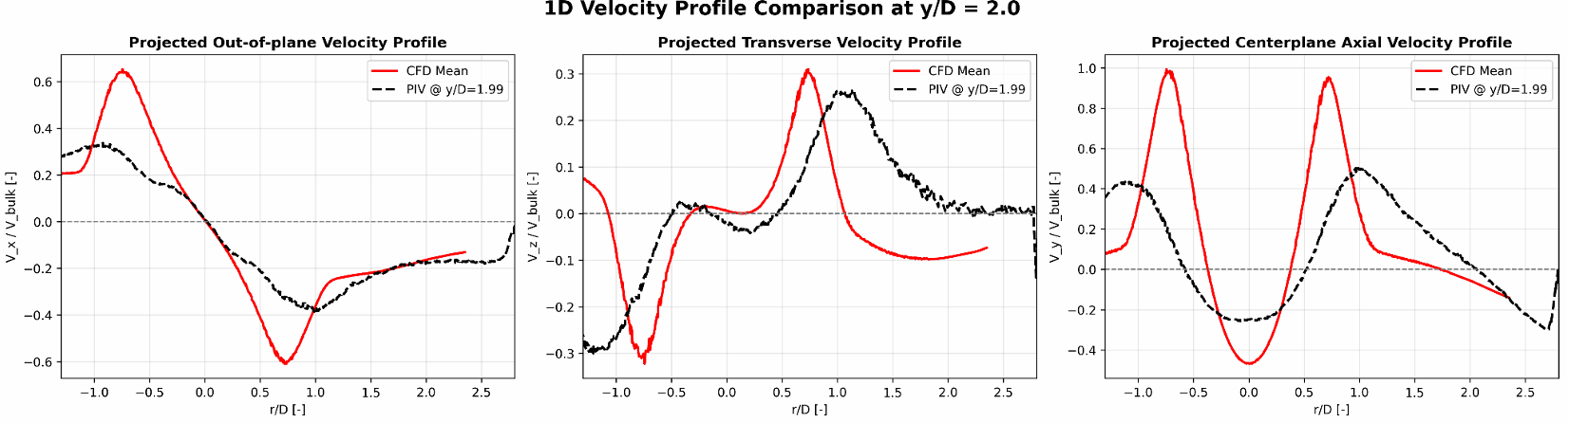
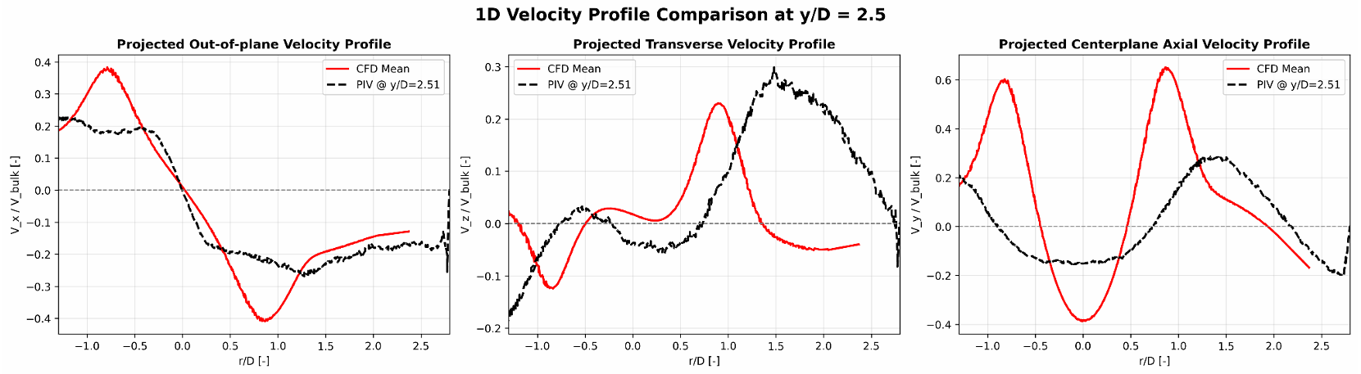
Appendix B: CFD vs PIV

Slide 26
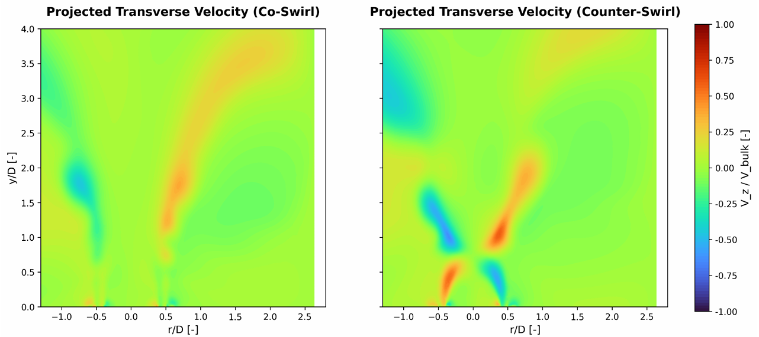
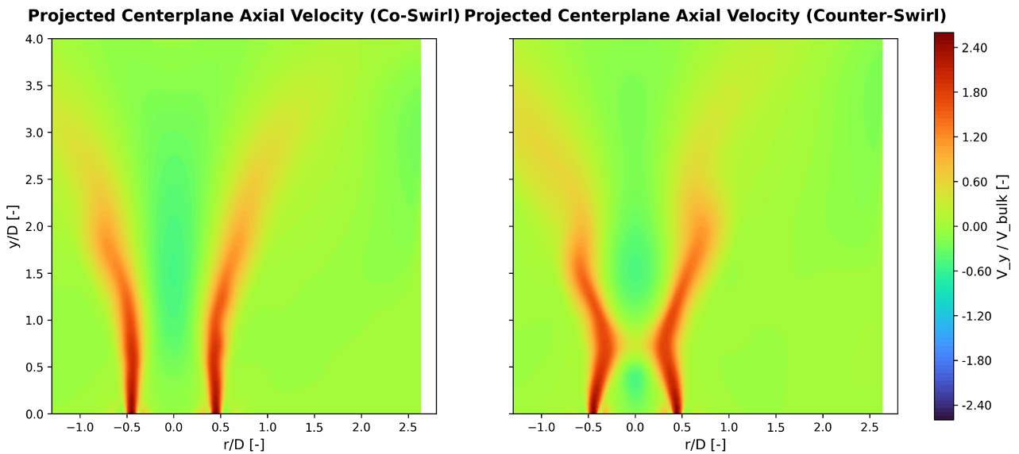
Appendix B: Co vs Counter
Counter-Swirl Aerodynamics: Reversing the inner swirl generates intense interfacial shear between the opposing rotational streams. ​

Slide 27
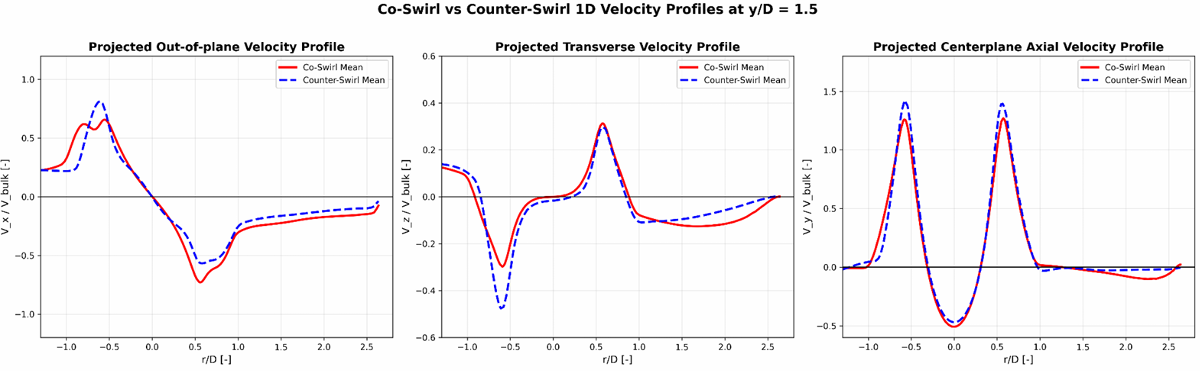
Appendix B: Co vs Counter

Slide 28
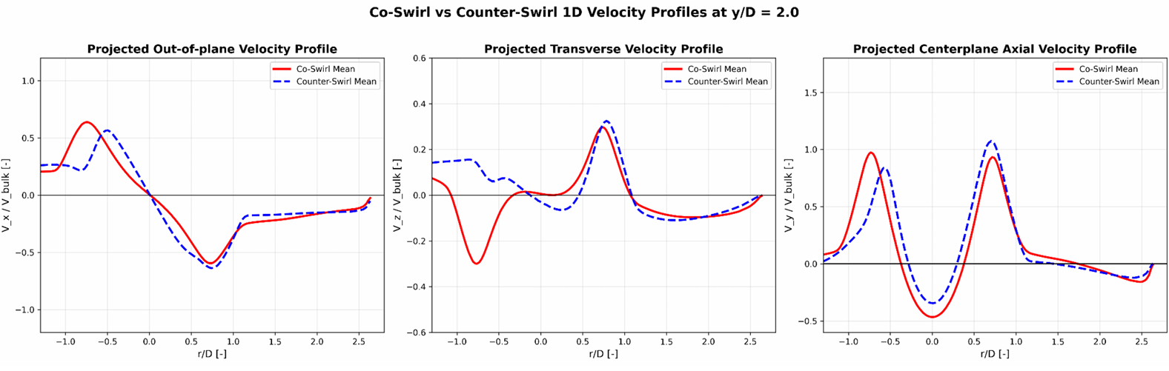
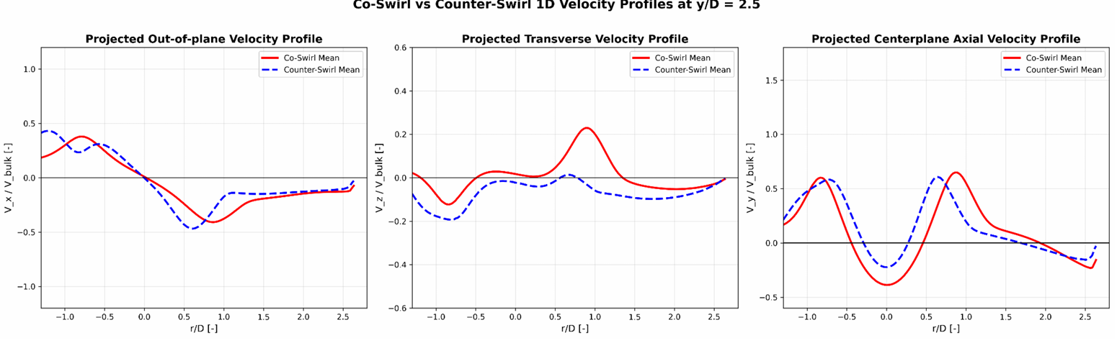
Appendix B: Co vs Counter

Slide 29
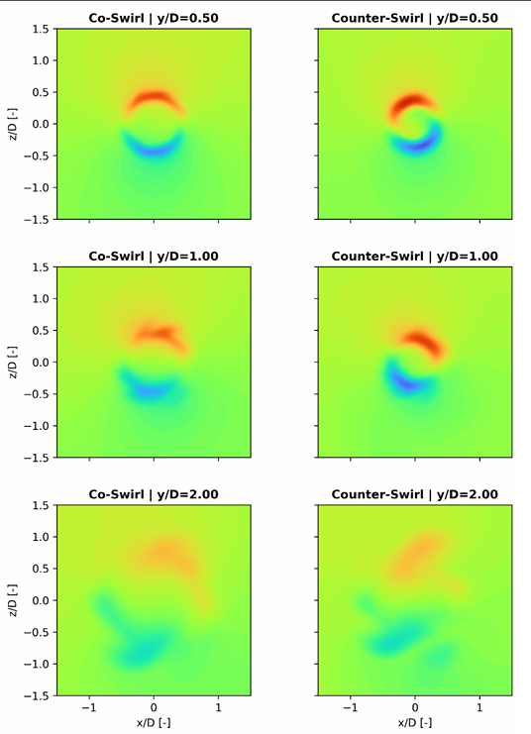
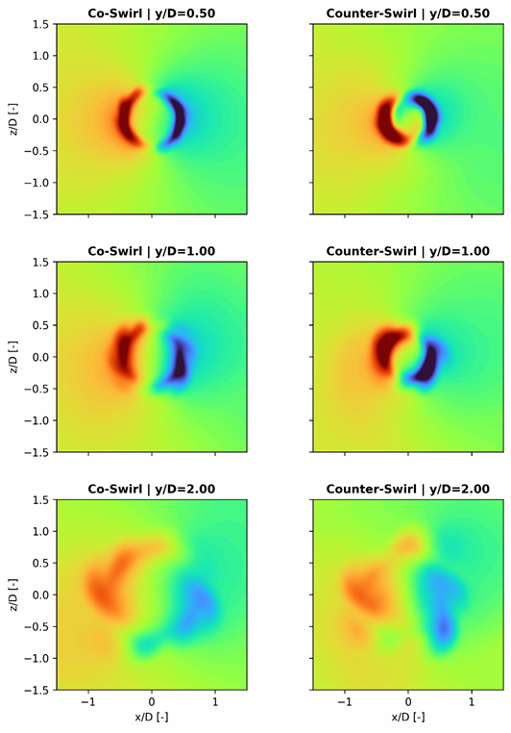




Appendix B: CRZ development downstream
Evolution of Vx velocity
Evolution of Vz velocity
Evolution of Vy velocity
CRZ Collapse: The opposing momentum in counter swirl suppresses centrifugal expansion, preventing the flow from inducing the strong adverse axial pressure gradient required to sustain vortex breakdown, ultimately causing the CRZ to narrow and collapse into a forward-moving turbulent jet. ​
Result: The wide, aerodynamically stable recirculation zone narrows & weakens, transitioning into a more jet-like, forward-moving core.​

Slide 30



Appendix B: TKE
Co-Swirl's Sustained Momentum: In the co-rotating baseline, uniform rotation allows the flow to preserve its angular momentum. As a result, the TKE generation is sustained and actively distributes along the expanding outer shear layers, migrating radially outward as it moves downstream.
Counter-Swirl's Premature Sink: Reversing the inner swirl creates a region of extreme, localized shear right at the interface of the two jets at the dump plane. This violent velocity gradient acts as a massive, premature "sink", rapidly extracting kinetic energy from the mean swirling flow early in the domain
Turbulent Kinetic Energy acts as a primary indicator of momentum dissipation within the flow field.

Slide 31

Appendix C: Other Co-swirl configurations with premixing
The EINOx Metric: which measures the absolute mass of NOx generated per unit mass of fuel consumed (g/kg H₂) to provide a combustor-independent comparison​

